Slide 1
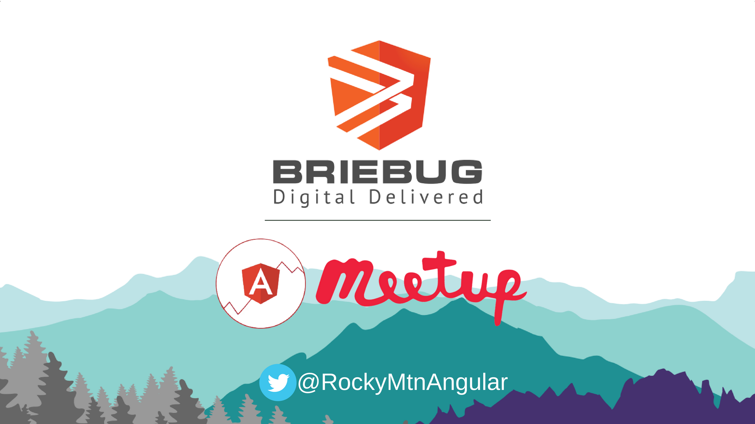

Slide 2
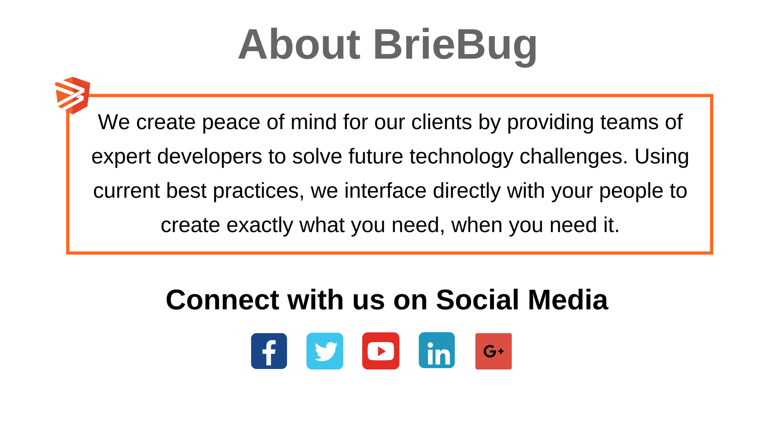

Slide 3
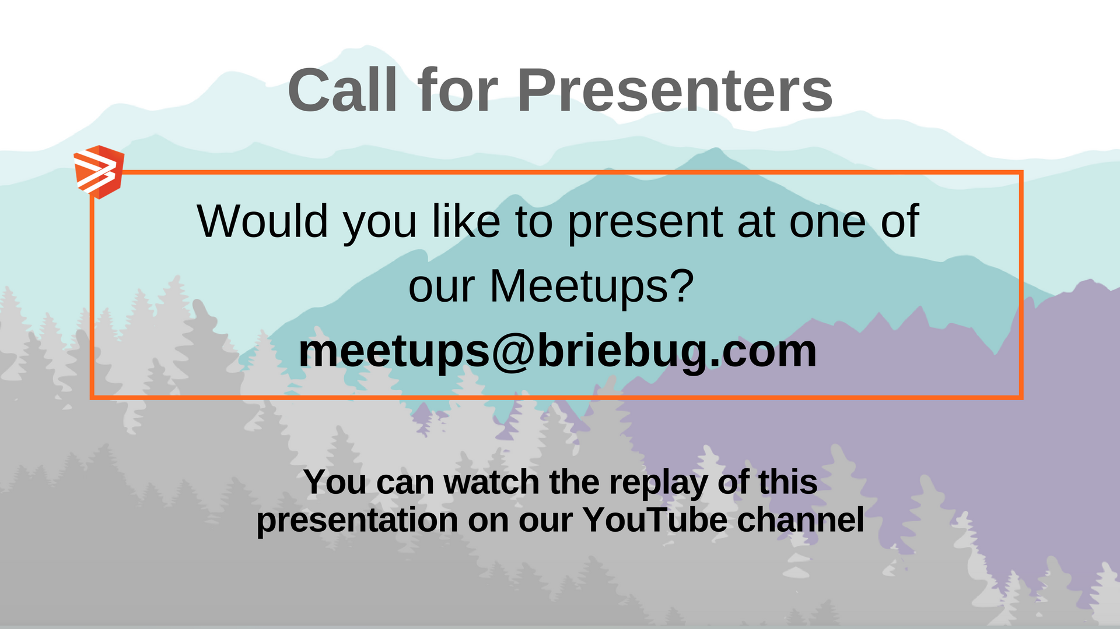

Slide 4


Slide 5
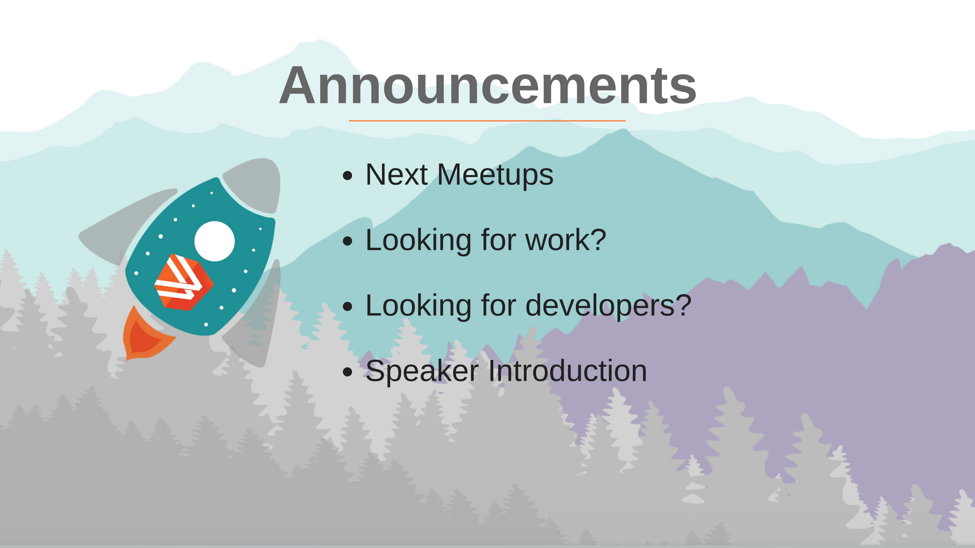

Slide 6
Introduction to GraphQL
Frank Sheiness
March 28, 2018
Rocky Mountain Angular Meetup

Slide 7

Who am I?
Frank Sheiness
Principal Engineer II at Charter Communications
Sysadmin-turned-Web Application Developer
Recent transplant to Denver from Austin, TX
Billiards and tabletop gamer
https://www.linkedin.com/in/frank-sheiness
https://github.com/syndesis
frank@dough.net
Angular · Ionic · ngrx · GraphQL · Firebase · Node.js

Slide 8

What are we going to talk about?
What is GraphQL?
GraphQL implementations – Back and Front end
GraphQL vs REST
Questions
+

Slide 9
What is GraphQL?
A query language for APIs and a runtime for fulfilling those queries with your existing data
Response to modern web application needs
Alternative to REST
Developed internally by Facebook in 2012
Released publically in 2015
Specification
http://facebook.github.io/graphql/October2016/
https://github.com/facebook/graphql
Notes:
Ask if anyone is currently using GraphQL

Slide 10
Who is using GraphQL
Airbnb
Coursera
Credit Karma
Dailymotion
Facebook
Github
Intiuit
Meteor
Opentable
New York Times
Intuit
Pinterest
Shopify
Spotify
Ticketmaster
Twitter
Wayfair
Yelp
You - as soon as this demo is over!

Slide 11
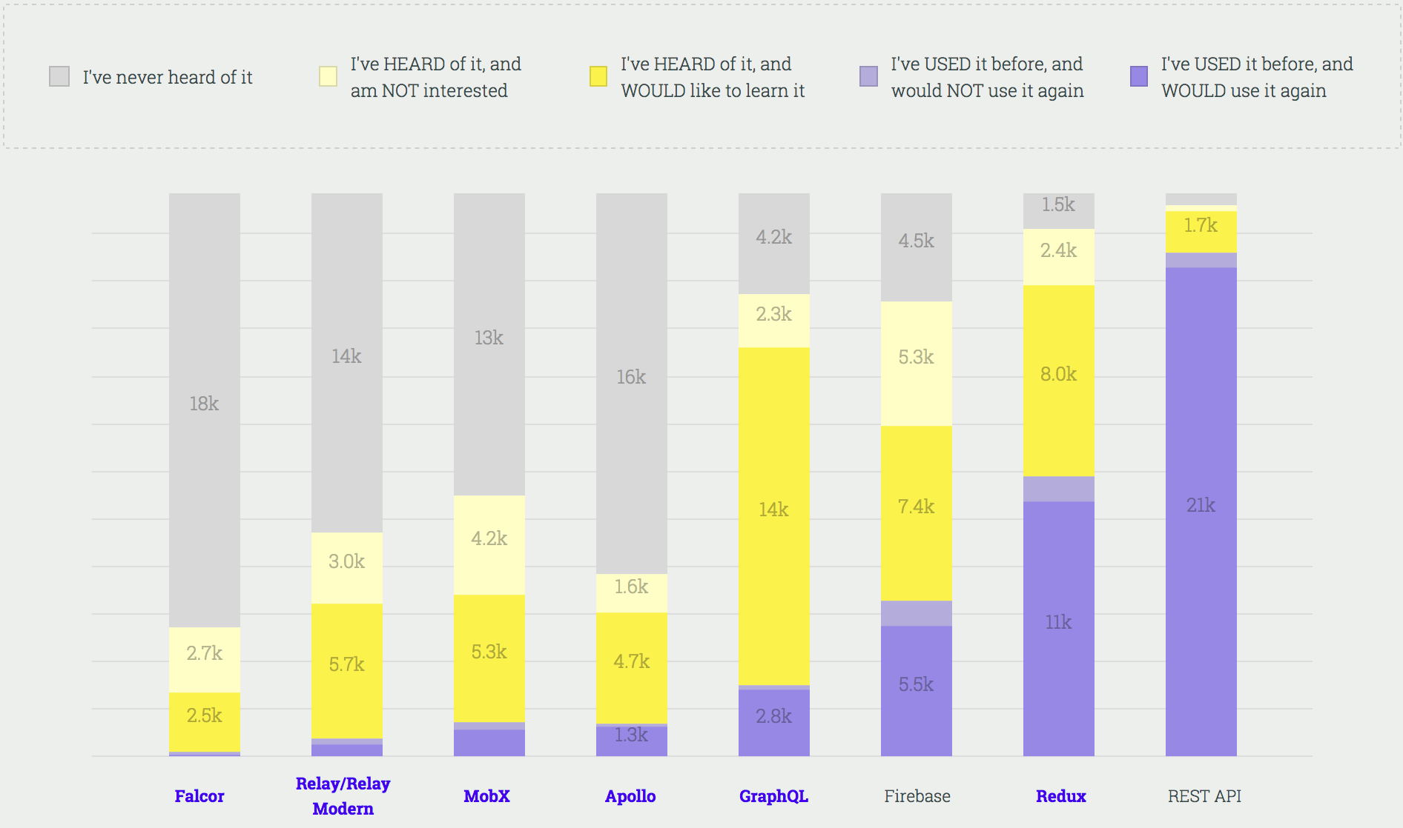
https://stateofjs.com/2017/state-management/results/

Slide 12
Why did Facebook create GraphQL?
Invented during the move from HTML5 to native
Problems encountered using REST
Hierarchical - Multiple round trips may overload the network (mobile)
Client depends on server – breaking changes
GraphQL is strongly-typed
Introspection
Notes:
Needed a data-fetching API powerful enough to describe all of Facebook, yet simple enough to be easy to learn and use by product developers.
We don't think of data in terms of resource URLs, secondary keys, or join tables; we think about it in terms of a graph of objects and the models we ultimately use in our apps
Each level of a GraphQL query corresponds to a particular type, and each type describes a set of available fields. Similar to SQL, this allows GraphQL to provide descriptive error messages before executing a query.
A GraphQL server can be queried for the types it supports. This creates a powerful platform for tools and client software to build atop this information like code generation in statically typed languages, frameworks and IDEs
GraphiQL helps developers learn and explore an API quickly without grepping the codebase or wrangling with cURL.

Slide 13
GraphQL Software

Slide 14
GraphQL Backend Servers
Node middleware libraries
Express
Hapi
Koa
Apollo-server
GraphQL BaaS
Graphcool
Scaphold
PostGraphile
Implementations in a wide variety of languages:
Java
PHP
Python
Ruby
Go
Scala
.NET

Slide 15
A basic GraphQL Schema
type Author { id: Int! firstName: String lastName: String ₊ posts: [Post] } type Post { id: Int! title: String author: Author votes: Int } # the schema allows the following queries: type Query { posts: [Post] author(id: Int!): Author } # this schema allows the following mutation: type Mutation { upvotePost(postId: Int!): Post }

Slide 16
PostGraphile API Server
https://www.graphile.org/postgraphile/introduction/
FKA PostGraphQL
Currently In Beta
Examines your database and automatically generates an API
Can be used standalone or as a node.js middleware library
JWT handling
Extensible with plugins
Filter Plugin
Advanced SQL operations can be performed with stored procedures

Slide 17
Postgres Schema - demodb
CREATE TABLE author (
author_id serial PRIMARY KEY,
first_name text,
last_name text
);
CREATE TABLE posts (
post_id serial PRIMARY KEY,
title text,
votes integer,
author integer NOT NULL REFERENCES author(author_id)
);

Slide 18
Start Postgraphile standalone server
$ postgraphile –c postgres://localhost:5432/demodb
PostGraphile server listening on port 5000 🚀
‣ Connected to Postgres instance postgres://localhost:5432/demodb
‣ Introspected Postgres schema(s) public
‣ GraphQL endpoint served at http://localhost:5000/graphql
‣ GraphiQL endpoint served at http://localhost:5000/graphiql

Slide 19
PostGraphile API From Schema
Queries
Mutations
allAuthors
author
authorByAuthorId
post
allPosts
postByPostId
createAuthor
updateAuthor
updateAuthorByAuthorId
deleteAuthor
deleteAuthorByAuthorId
createPost
updatePost
updatePostByPostId
deletePost
deletePostByPostId

Slide 20
GraphQL Frontend Client
There are client implementations in all the same languages as the backend servers, but we’re going to focus on the one that I use with Angular
Apollo-client
Created by Meteor Development Group
Works with: Angular, React, Vue, Android, iOS, Ember, Meteor
Angular specific version
https://www.apollographql.com/docs/angular/

Slide 21
Getting Started - Angular
$ yarn add apollo-angular \
apollo-angular-link-http \
apollo-cache-inmemory \
apollo-client \
apollo-link-context \
apollo-link-error \
graphql-tag \
graphql

Slide 22
Apollo-Client Angular Module
Let’s see some code!

Slide 23
GraphQL Queries
Declare data needs as you write your query
Model data the same way you think about it
Result looks the same as the query
Allows components to fetch their own data in the format they need it

Slide 24
Gql strings
Operation Name
Query
Mutation
Variables
Fragments

Slide 25
Example Query
Query - String
Response - JSON
{
user(id: 1) {
id
name
email
address {
street
city
state
zip
}
}
}
{
“user” : {
“id”: 1,
“name”: “Dennis Moore”,
“email”: ”dmoore@example.com”,
“address”: {
“street”: “123 Main St.”
“city”: “Denver”,
“state”: “CO”,
“zip”: “80014”
}
}
}

Slide 26
QueryRef
valueChanges: Observable<ApolloQueryResult<T>>;
result(): Promise<ApolloQueryResult<T>>;
currentResult(): ApolloCurrentResult<T>;
getLastResult(): ApolloQueryResult<T>;
getLastError(): ApolloError;
resetLastResults(): void;
refetch(variables?: V): Promise<ApolloQueryResult<T>>;
fetchMore(fetchMoreOptions: FetchMoreQueryOptions & FetchMoreOptions): Promise<ApolloQueryResult<T>>;
subscribeToMore(options: SubscribeToMoreOptions): () => void;
updateQuery(mapFn: (previousQueryResult: any, options: UpdateQueryOptions) => any): void;
stopPolling(): void;
startPolling(pollInterval: number): void;
setOptions(opts: any): Promise<ApolloQueryResult<T>>;
setVariables(variables: V, tryFetch?: boolean, fetchResults?: boolean): Promise<ApolloQueryResult<T>>;

Slide 27
Queries
Variables
FetchPolicy
ErrorPolicy

Slide 28
Mutations
Observable
Update Cache
refetchQuery
update

Slide 29
API Service

Slide 30
Authentication
const authLink = new ApolloLink((operation, forward) => { const token = localStorage.getItem('token'); const authorization = token ? `Bearer ${token}` : null; const headers = new HttpHeaders() .append('Authorization', authorization); operation.setContext({ headers: headers }); return forward(operation); });

Slide 31
Caching
Apollo InMemory Cache
dataIdFromObject

Slide 32
Development Tools and Resources
Graphiql: An In-browser IDE for exploring GraphQL
Requires browser plugin for Authentication Header
Graphql Playground
IDE / Editor Plugins
Webstorm
VS Code
Apollo Client Devtools Chrome Extension
https://gitter.im/graphile/postgraphile
https://www.apollographql.com/slack

Slide 33
GraphQL and REST - Similarities
Resources with IDs
Utilize standard HTTP requests
Serialize data in JSON
Endpoints call functions on the server

Slide 34
GraphQL vs REST Differences and Advantages
GraphQL
Query Language Specification and collection of tools
The endpoint is separate from how you fetch an object
The server declares what resources are available and the client asks for what it needs at the time
Clients with different needs can construct their own queries
Always offers the smallest possible request.
One query can call many resolvers to construct a nested response
Improved deprecation
REST
Architectural Concept
The endpoint is the identify of the object
Size and shape of response is determined by the server
Clients with different needs require custom endpoints
One query usually calls one route handler.
Verbs, HTTP Response codes, PATCH???
Wide array of implementations which may or may not be RESTful
Frontend / Backend miscommunication

Slide 35
GraphQL vs REST – Summary
REST can be implemented in ways to give it many of the GraphQL advantages
Sparse Fieldsets / Partials: JSON-API
http://jsonapi.org/
GET /articles?fields[articles]=title,body
Types, Schemas and Data Inclusion: JSON Schema and HATEOAS
http://json-schema.org/
Evolution
OData (Open Data Protocol) defines a set of best practices for building and consuming RESTful APIs
http://www.odata.org/
GraphQL has opinionated, convenient solutions

Slide 36
GraphQL vs Rest – Summary (continued)
If your REST API is following good practices, then the advertised advantages of GraphQL seem to fall a bit short.
Allowing careful evolution instead of global versioning
Serializing data instead of returning directly from data store
Implementing sparse fieldsets to allow slimming down response sizes
Outlining data structures with JSON schema
Offering binary alternatives to JSON
If you need a highly query-able API, expect an array of clients that need small and different data, and can restructure your data to be inexpensive to query, then GraphQL is likely to fit your needs.
You don’t have to choose! Use both concurrently!

Slide 37
Questions?

